Slide 1
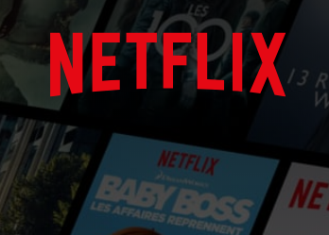
NETFLIX DATA VISUALIZATION 2017
FRANCOISE
CHATEAU-DEGAT
Notes:
This presentation is to help financial analysts by creating some of the visualizations for a stock profile of Netflix.

Slide 2
List of the visualizations
Netflix quaterly data 2017
Performance of the earnings per share 2017
Netflix Earning and Revenue per Quarter 2017
Netflix stock versus Dow Jones stocks 2017

Slide 3
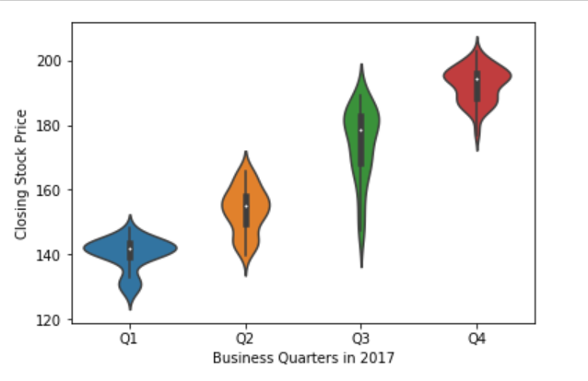
A visualization of the distribution of the stock prices for Netflix in 2017
Notes:
Looking at the visualized data, the first impressions is that the Stock Price is quite constant and grow during the year.
In what range(s) did most of the prices fall throughout the year? In range Q3
What were the highest and lowest prices? The Highest price was around 200 and the lowest around 140

Slide 4
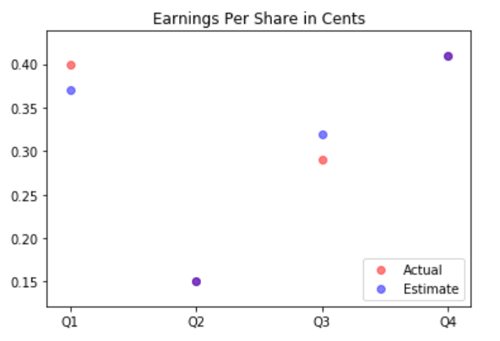
A visualization and a summary of Netflix stock and revenue for the past four quarters and a summary
the actual and estimate earnings per share
Notes:
What do the purple dots tell us about the actual and estimate earnings per share in this graph? These purple dots are visible for Q2 and Q4. Actual and estimate are mixed. We got around 0.40 for Q4 and around 0.15 for Q2.

Slide 5
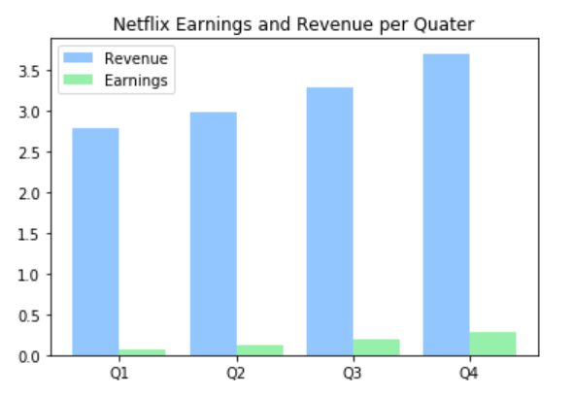
A visualization and a brief summary of their earned versus actual earnings per share
Notes:
We can see that the Revenue are growing through the year and the same for the Earnings.
Revenue trend is about 1.5 growth every quarter
Earnings follow also a trend, less around 0.5 every quarter
Roughly this is representing around 2 to 5%

Slide 6

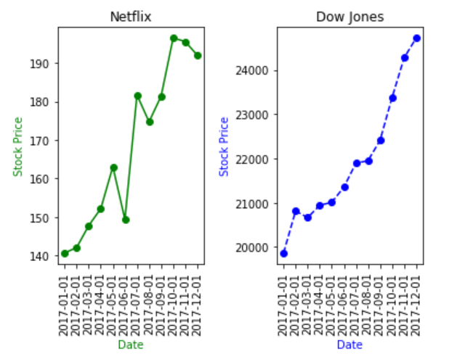
A visualization of Netflix stock against the Dow Jones stock (to get a sense of the market) in 2017
Notes:
Netflix perform relative identically as Dow Jones Industrial Average in 2017
Netflix was more volatile. Dow Jones is definitely more constant
The prices of the stocks where not stable for Netflix during June and July

Slide 7

Thank you !

